Slide 1
JSX (JavaScript XML)
HTML inside JavaScript.
JavaScript inside HTML.
React look like HTML but behave like JavaScript.
JSX is not HTML — it’s syntactic sugar over React.createElement()
Notes:
Ye 4rth wala line aap interviewer ko bol doge na to interviewer khus ho jaayega, aree..! Areee ruku sun lo pura pahle siddha chair se uth ke interview dene jane lagte ho, puri baat to suno meri…!!!🙂🙂🙂🙂

Slide 2
JSX (JavaScript XML) is a syntax extension for JavaScript used in React.
It lets you write HTML-like code inside JavaScript.
Notes:
Give idea of how html and js work differently without react

Slide 3
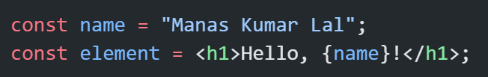
Embedding Expressions
Valid Expressions:
Variables
Function calls
Ternary expressions
Mathematical operations
Statements like if-else, for, etc. are not allowed.
Note:
JSX and template literals both follow this rule: Only expressions can go inside {} or ${} and not statements.

Slide 4
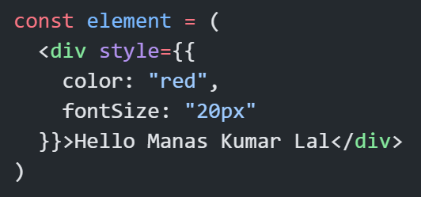
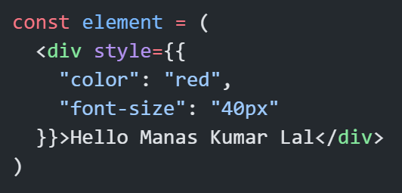
JSX with Inline Styles
JSX style is an object, not a string

Slide 5
Conditional Rendering in JSX
Using Ternary Operator
const isLoggedIn = true;
<p>{isLoggedIn ? "Welcome back!" : "Please log in."}</p>;
Short-circuit rendering
const isAdmin = true;
const element = isAdmin && <p>Admin Panel</p>;

Slide 6
JSX with Loops (Arrays)
JSX doesn’t support for, but we can use .map().
const items = ["Manas", "Muskan", "Mehek"];
<ul>
{items.map((item, index) => (
<li key={index}>{item}</li>
))}
</ul>

Slide 7
JSX is an Expression
Assign it to variables
Pass as props
Return from functions
function callMe(otherJSX) {
return <h1>Suno, {otherJSX}</h1>;
}

Slide 8
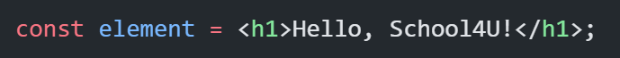
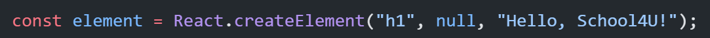
Behind the Scenes
Compiled to React.createElement() behind the scenes.
JSX:
Compiled:
React.createElement(type, props, ...children)

Slide 9
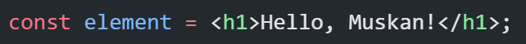
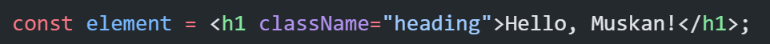
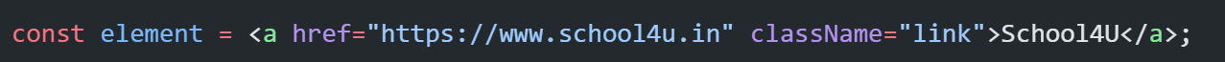

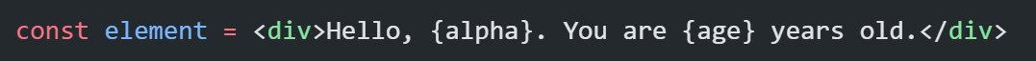
Practice:
Convert these JSX into createElement syntax:
Notes:
Give idea of how html and js work differently without react

Slide 10
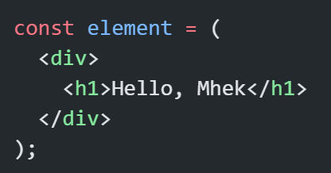
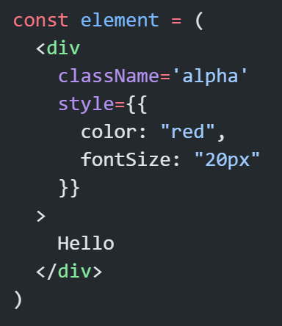
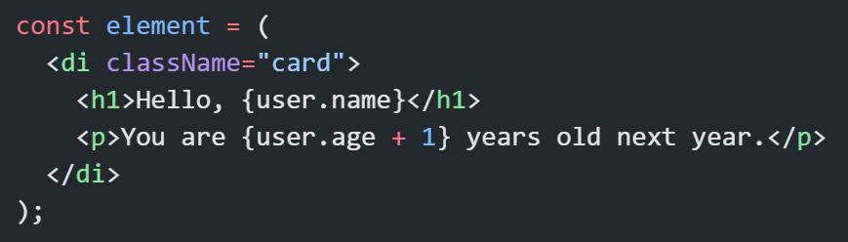
Notes:
Give idea of how html and js work differently without react

Slide 11
JSX Rules:
Must return single parent element. Wrap with div (<div></div>) or fragments (<></>)
Use “className” and “htmlFor” props instead of “class” and “for” attribute. (class & for are reserved keywords in JS)
Self-closing tags are used for elements without children.
Cannot use if-else directly — use ternary or logical &&
JSX supports only expressions inside {} – not statements.

